Slide 1
Web-editor for reproducible pipelines
Detailed design

Slide 2
Product description
A web application and a visual studio code extension for editing pipelines with auto-saving and automatic syntax and cohesion checking, embedded into the “MLOps Platform”.
MLDev experiments configurations CRUD.
Online editor with syntax highlighting, formatting.
Real Time collaboration with built-in git support system.
Experiments visualizer.
Team: Daniil Fedorov (Architect, system analyst), Sergeev Ilya (Architect, full-stack developer), Shtanov Andrey (Architect, UI-developer)
Repo: https://github.com/dr0p-table-users/asd
Report: https://docs.google.com/presentation/d/14Q5wD-8bEsWRHIdj6A_nMqwvFWOSnHYgY6U_vroyzd8/edit?usp=sharing

Slide 3
System architecture
Project drivers:
Educational constraints (use microservices)
Performance constraints (runs on client, possibly in one thread)
Usage constraints (requests appear from the UI)
Platform independence (WebEditor or VSCode extension)
Project principles:
Microservices (micro-frontends & micro-backends)
Asynchronous communication
Reactive UI

Slide 4
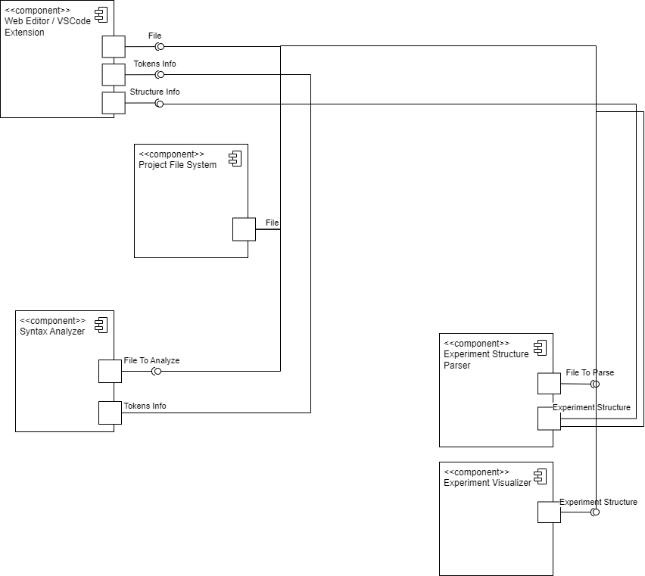
System architecture
(Components perspective)

Slide 5
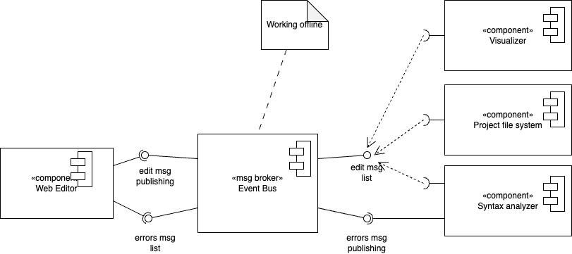
Design case 1 (UML2)
Problem: by definition, microservices interact through an unreliable channels. This is especially crucial for front-end applications. Hence, a significant data loss may appear.
Solution: Event Bus pattern
Due to relatively large size of messages in the bus (e.g. code changes), it is preferred to implement with localStorage. Components may be connected to the interface using polling techniques. The UX may be improved with offline-saving of the contents, stored in the bus.

Slide 6
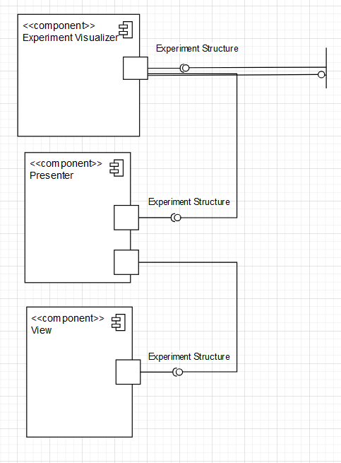
Design case 2 (UML2)
Problem: Due to performance constraints the app’s UI should be rendered as infrequently as possible (not each frame). Also, the visualizer microservice should be standalone.
Solution: Model-View-Presenter (MVP) Pattern + Observables
Model: contains yaml code structure. Updates tree when code changes.
View: graphical display of the tree.
Presenter: updates code (in potential future).

Slide 7
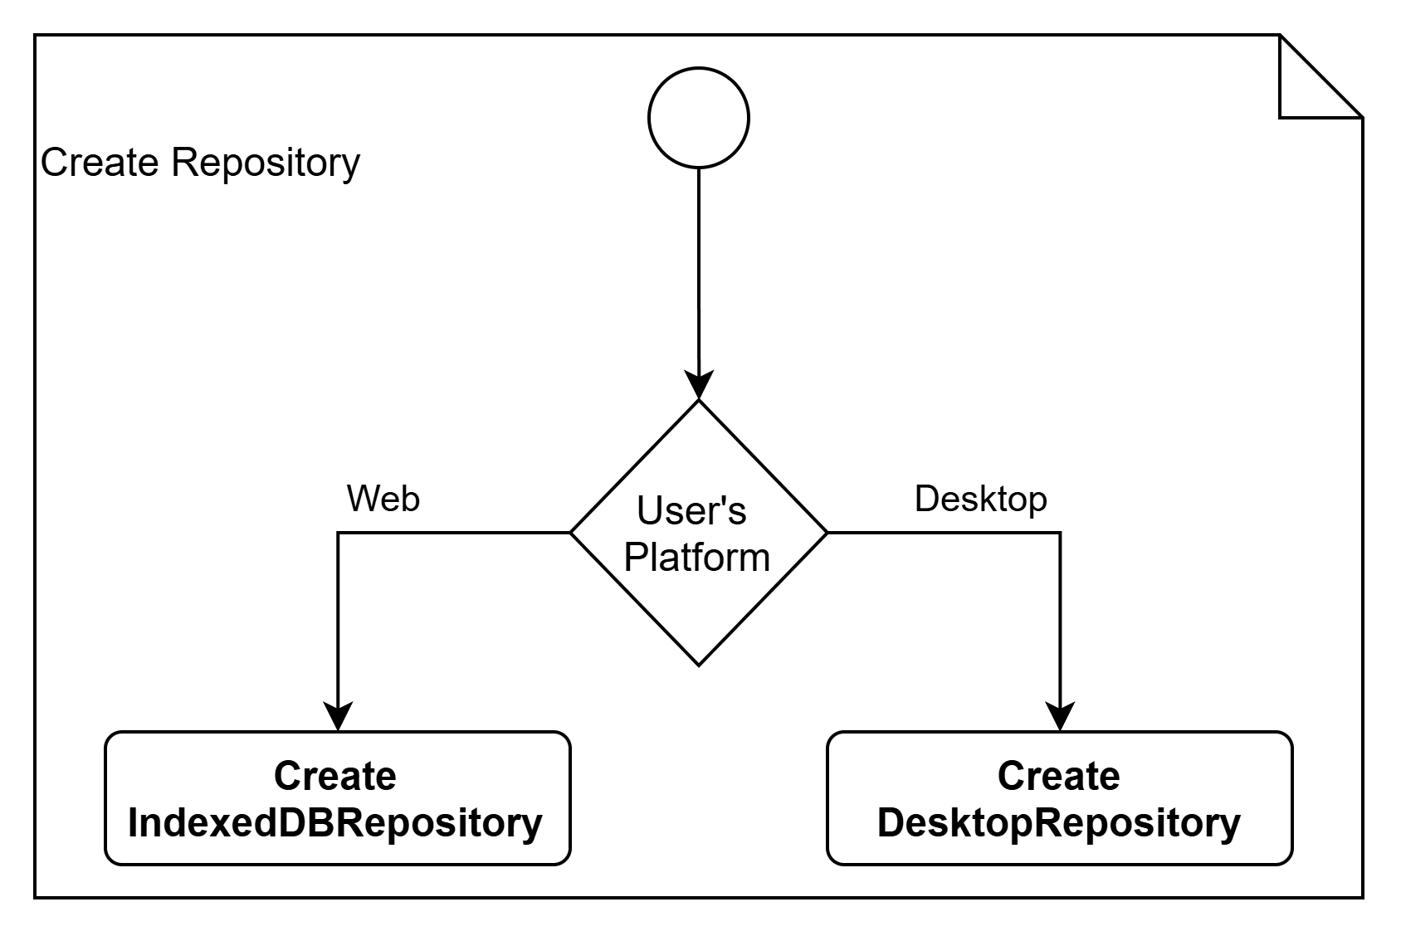
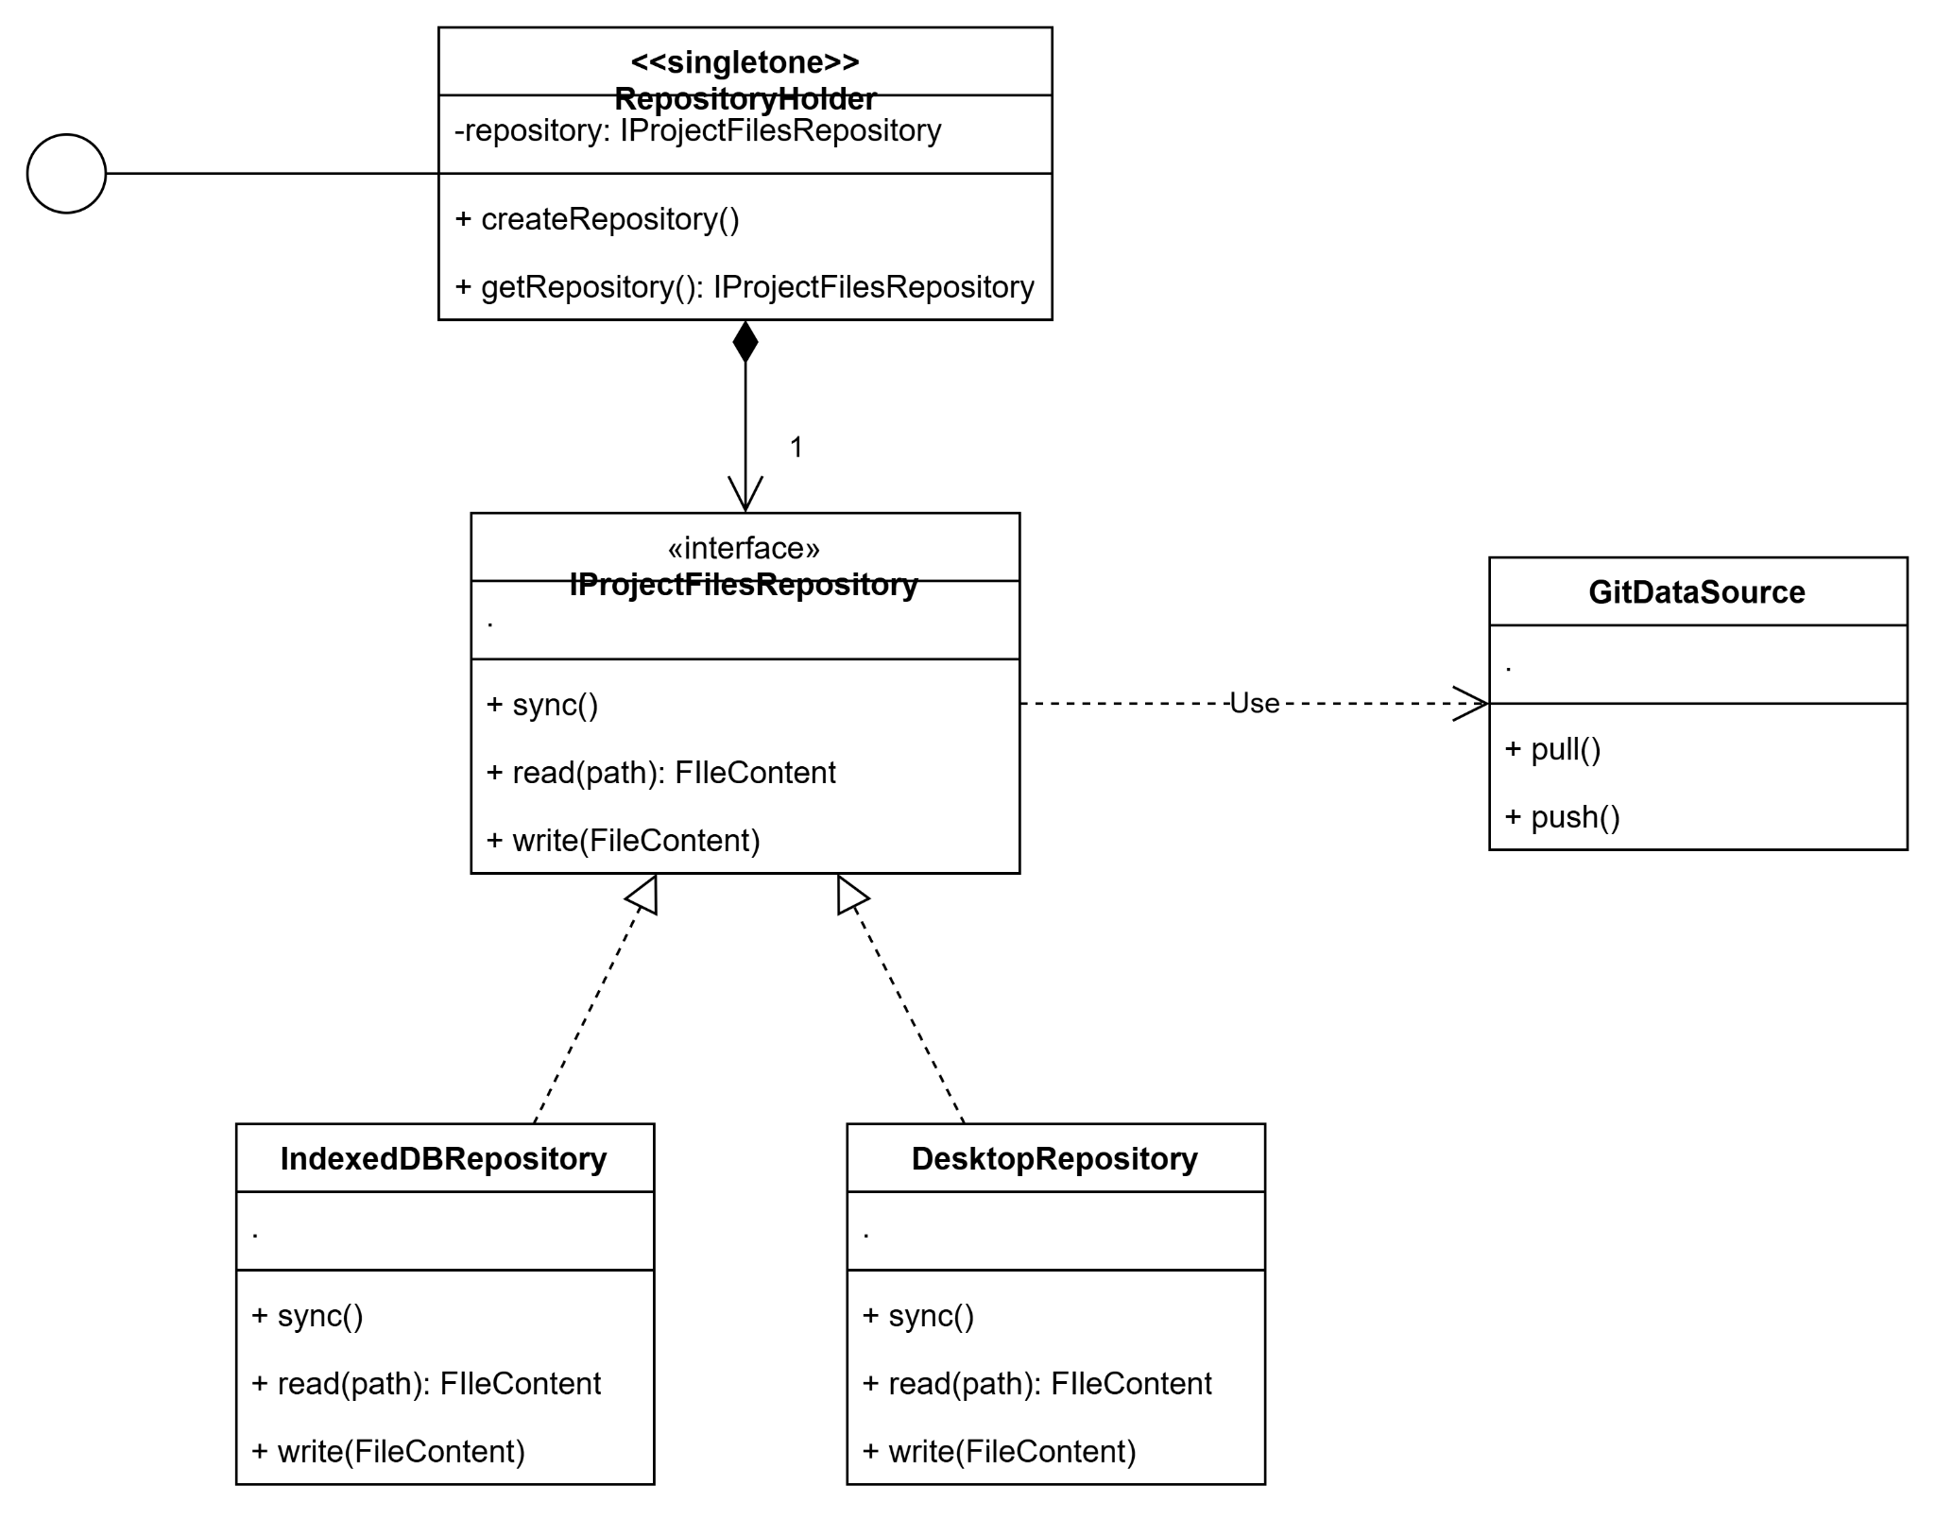
Design case 3 (UML2)
Problem: due to cross platform considerations, our project files can be stored in desktop file system or in WebBrowser file storage. Our codebase shouldn’t become more complicated due to different data sources.
Solution: Repository Pattern
Behaviour diagram
We’ll use repository pattern so we can work with user’s file system, indexeddb, git depending on current user’s environment. Meanwhile, the rest of the codebase won’t be changed due to repository’s implementation changes.
We’ll also use singleton and fabric method for easy interface with our repository class.
Structure diagram

